Slide 1
MBLOCK

Slide 2
What is MBLOCK ?
a software that is built on the graphical programming language called SCRATCH
tries to provide coding education for children with block-based programming logic, and makes learning coding fun with hardware and software integration.

Slide 3
There are ready-made code blocks in the mBlock program, and we can create code blocks like combining puzzle pieces by dragging these code blocks onto the stage with the mouse.

Slide 4
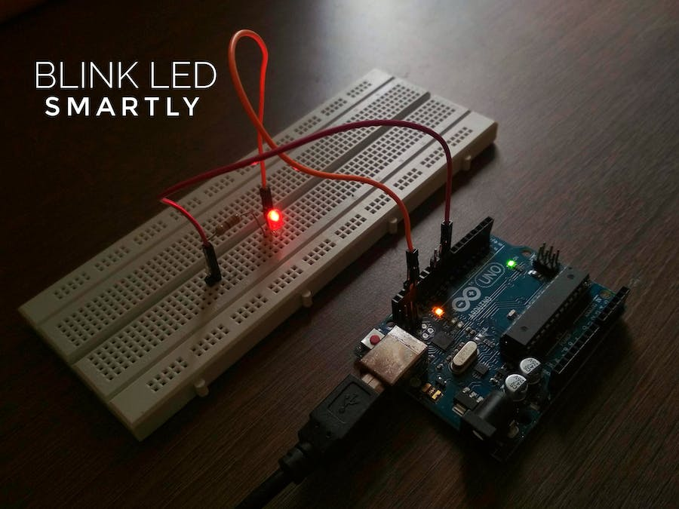
TASK 1-Blinking Led

Slide 5
Download MBLOCK programme
Connect the board and computer via USB cable
Select the Serial Port of the Board (Ardunio Uno)
Write the codes and upload the Ardunio

Slide 6
Write the codes and upload the Ardunio

Slide 7
Task 2:Line Follower Robot

Slide 8
Write these codes and
make your robot move
on the black path
you will draw.

